Slide 1


AMERICAN INTERNATION UNIVERSITY-BANGLADESH
Software Defect Prediction Using- Object Oriented Metrics
Kuratali,Khilket, Dhaka

Slide 2
AMERICAN INTERNATION UNIVERSITY-BANGLADESH
STUDENT NAME | STUDENT ID
Tazrian Zaman Tushti | 19-39433-1
Tasnim Khondoker Mim | 19-39527-1
Md Abdullah Al Hossain | 19-40083-1
Afique Sadique | 19-39708-1
Supervisor’s Name
Kazi Sadia
Lecturer
Faculty of Science and Technology
American International University-Bangladesh

Slide 3

Outlines
INTRODUCTION
MOTIVATION
OBJECTIVE
RESEARCH QUESTION
LITERATURE REVIEW
PROPOSED METHODOLOGY
WORKING PROCEDURE
CLASSIFIER SELECTION
RESULTS
FUTURE WORK
REFERENCE
1

Slide 4
INTRODUCTION
As complexity of software development is increasing, it has become difficult to ensure the quality of software.
Early detection of defects can reduce time and cost of software development.
SDP can help to ensure the quality of software as early detection of errors will help testers to concentrate the modules that require detailed testing
ML can be used to predict the fault proneness in class level
OO approach is used nowadays than procedural programming so ML techniques can be used to predict bugs in OO projects.
2

Slide 5
MOTIVATION
Testing every module consumes a lot of time and resources
Applying same testing effort to all modules is not optimized since the distribution of defects is not uniform
So testers should identify defect prone modules as early as possible and prioritize their testing effort
So SDP can play an important role by identifying these errors early
3

Slide 6
OBJECTIVE
This research is focused to develop a model for software defect prediction using object-oriented metrics.
Assure software quality
Reduce the number of bugs by giving extensive testing to modules
Exploring the relation of various OO metrics with bugs.
4

Slide 7
RESEARCH QUESTION
The primary goal of this research is to build a bug prediction model based on different metrics and compare different ML methods. In this paper the following research questions has been addressed:
How different metrics can give accuracy for models and which outperforms most for finding bugs?
Are the results accurate enough to apply this process in actual software projects?
Which OO metrics are good predictor?
5

Slide 8
LITERATURE REVIEW
Software bug prediction using object-oriented metrics
Author- Dharmendra Lal Gupta , Kavita Saxena
A model for Object-oriented software bug prediction system was developed.
They used some open source projects like Tomcat 6.0, e-learning, Zuzel etc.
14 metrics have been selected for model creation
The model contains an average accuracy of 76.27%
6

Slide 9
LITERATURE REVIEW
Software fault prediction based on the dynamic selection of learning technique: findings from the eclipse project study
Author- Santosh S. Rathore, Sandeep Kumar
An approach is made based on a set of competitive and accurate learning techniques for building a fault prediction model.
Nine Object-oriented (OO) project datasets has been selected.
Naïve Bayes, Logistic Regression and K-Nearest Neighbor has been selected for the analysis.
Performance was based on AUC and the values were above or equal to 0.60 for all the cases.
7

Slide 10
LITERATURE REVIEW
Applying machine learning to predict software fault proneness using change metrics, static code metrics, and a combination of them
Author- Yasser Ali Alshehri, Katerina Goseva-Popstojanova, Dale G. Dzielski, Thomas Devine
The main goal was to find which algorithm performs best for code based metrics
Three machine learning algorithms were applied on three Eclipse release(2.0,2.1,3.0)
Naïve Bayes, logistic regression and J48 has been applied.
With respect to G score J48 has outperformed.
8

Slide 11
LITERATURE REVIEW
Empirical validation of object-oriented metrics for predicting fault proneness models
Author- Yogesh Singh,Arvinder Kaur, Ruchika Malhotra
This research paper aims to find the relation of Object-Oriented(OO) metrics with fault proneness at different severity levels of faults.
It has been evaluated to see which methods performs well in different severity levels of faults and empirically validate OO metrics given by Chidamber and Kemerer
The empirical study is based on public domain NASA dataset
DT and ANN model outperformed the LR model
9

Slide 12
LITERATURE REVIEW
Predicting Defects for Eclipse
Author- Thomas Zimmermann, Rahul Premraj , Andreas Zeller
Researchers conducted a work on the code based on the Eclipse programming environment.
The Spearman correlation was applied between the number of pre-release and post-release defects with the complexity metrics in the data set.
It suggests that the more complex code it, the more defects it has.
10

Slide 13
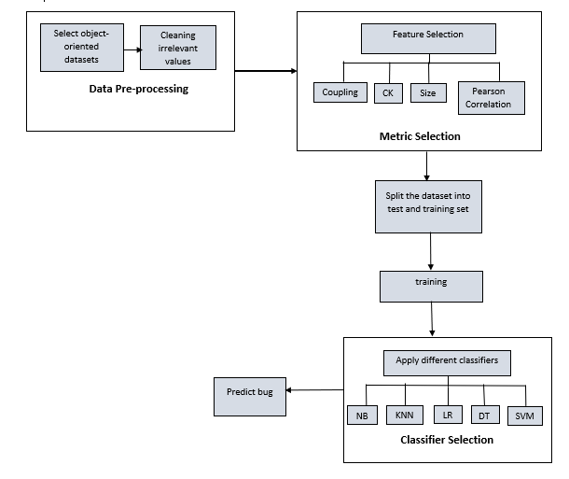
PROPOSED METHODOLOGY
Figure: Diagram for model construction of SDP
11

Slide 14
WORKING PROCEDURE
The whole process can be divided into 4 parts:
Data collection & Data Preprocessing: For analysis purpose, OO metrics were needed. So Eclipse dataset was used. Irrelevant data was removed.
Feature Selection: CK, Coupling, Size, Pearson Correlation
Further Processing: split the dataset into test and training set
Classifier apply
12

Slide 15
CLASSIFIER SELECTION
5 Machine Learning classifiers were used to construct the model:
Logistic Regression
Decision Tree
Naïve Bayes
K-Nearest Neighbor
Support Vector Machine
13

Slide 16
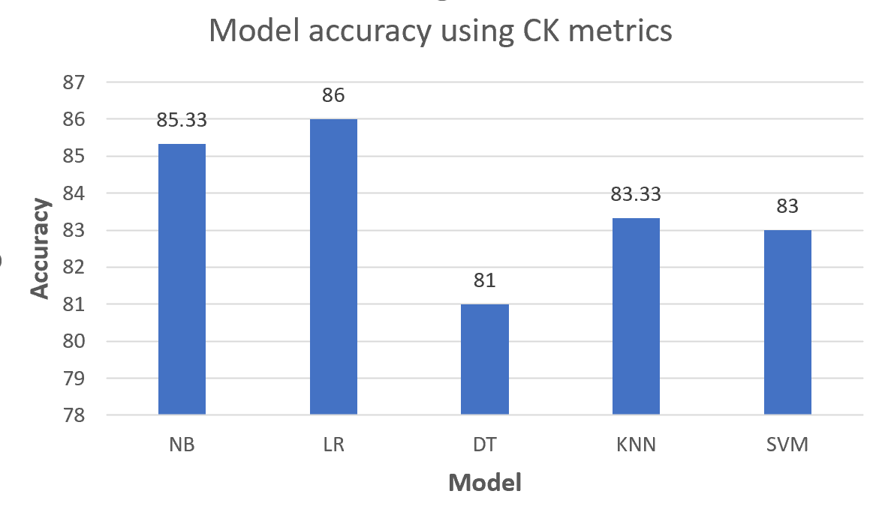
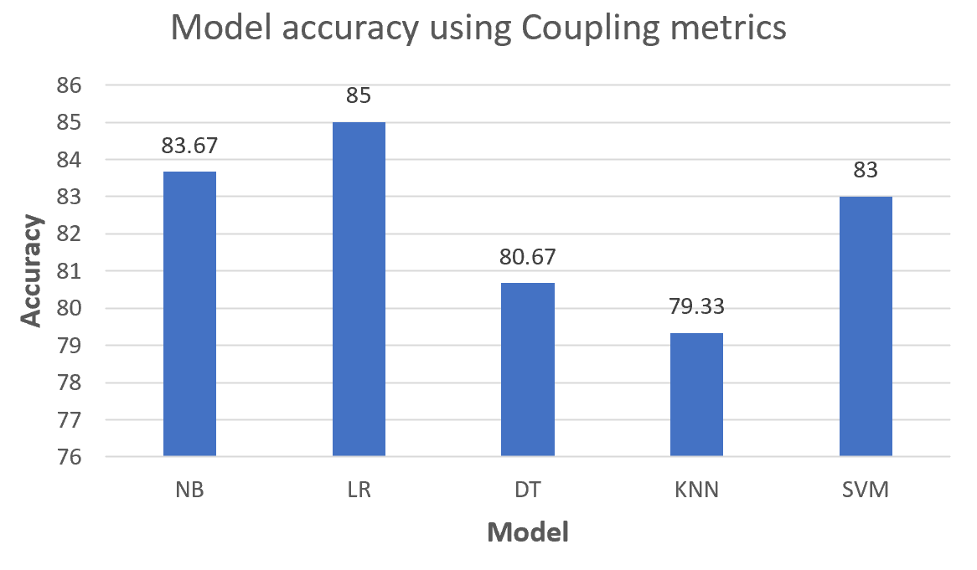
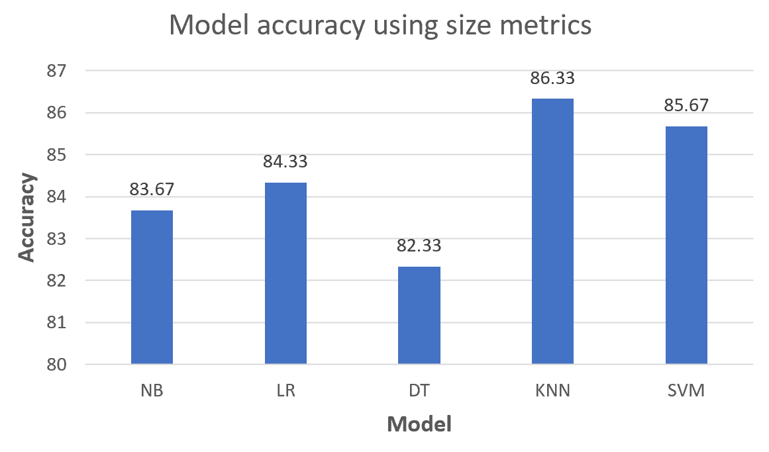
RESULTS
Figure 1: Model accuracy for CK metrics
Figure 2: Model accuracy for Coupling metrics
Figure 3: Model accuracy for Size metrics
14

Slide 17
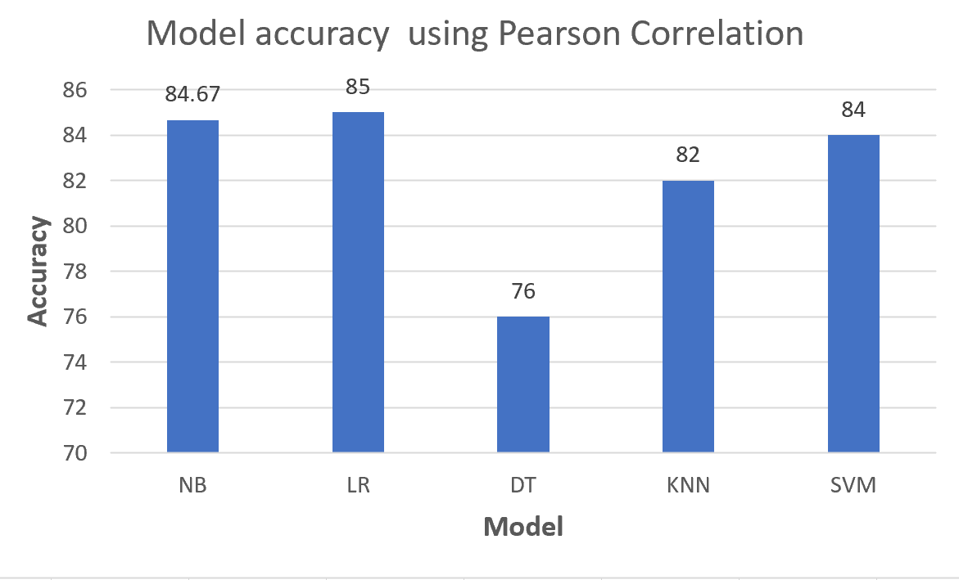
RESULTS
Figure 4: Model accuracy for Pearson Correlation
So, by applying Pearson Correlation, it is found that LR outperforms among all classifiers and these metrics are highly correlated with bugs from other metrics. For all metrics LR outperforms the most.
15

Slide 18
FUTURE WORK
Could be Implemented real software projects to test the models
Deep learning can be applied to test whether accuracy increases or not
Ensemble learning technique and Smote can be applied to increase accuracy
16

Slide 19
CONCLUSION
These days object-oriented has become an essential part of software environment.
The major purpose of this research is to explain the performance of less complex models with limited number of features which has been successfully implemented.
Using Machine Learning Techniques Logistic Regression has shown the best performance and contains the highest amount of accuracy among majority metric
K-Nearest Neighbor contains the highest accuracy after logistic regression.
Applying more algorithms in future creates a high possibility that the accuracy will be upgraded.
17

Slide 20
REFERENCE
S. K. Santosh S. Rathore, “Software fault prediction based on the dynamic selection of learning technique: findings from the eclipse project study,” The Author(s), under exclusive licence to Springer Science+Business Media, LLC, part of Springer Nature 2021, 2021.
A. K. ,. Y. S. Ruchika Malhotra, “Empirical validation of object-oriented metrics for predicting fault proneness at different severity levels using support vector machines ,” The Society for Reliability Engineering, Quality and Operations Management (SREQOM), India and The Division of Operation and Maintenance, Lulea University of Technology, Sweden 2011, 2011.
G. V. Dr. M.P. Thapaliyal, “Software Defects and Object Oriented Metrics - An Empirical Analysis,” International Journal of Computer Applications ·, 2010.
Y. S. A. K. a. R. M. K. K. Aggarwal, “Empirical Analysis for Investigating the Effect of Object-Oriented Metrics on Fault Proneness: A Replicated Case Study Research,” University School of Information Technology, GGS Indraprastha University, Delhi 110403, India, 2008.
A. K. ,. R. M. Yogesh Singh, “Empirical validation of object-oriented metrics for predicting fault proneness models ,” Springer Science+Business Media, LLC 2009, 2009.
18

Slide 21
REFERENCE
6. D. D. S. Marian JURECZKO, “Using Object-Oriented Design Metrics to Predict Software Defects,” Oficyna Wydawnicza Politechniki Wrocławskiej, 2010.
7. R. P. A. Z. Thomas Zimmermann, “Predicting Defects for Eclipse,” Third International Workshop on Predictor Models in Software Engineering, 2007
8. Z. M. J. W. M. I. B. A. a. A. E. H. Emad Shihab, “Understanding the Impact of Code and Process Metrics on Post-release Defects: A Case Study on the Eclipse Project,” Software Analysis and Intelligence Lab, 2010.
9. R. M. •. A. K. •. Y. Singh, “Empirical validation of object-oriented metrics for predicting fault proneness at different severity levels using support vector machines,” The Society for Reliability Engineering, Quality and Operations Management (SREQOM), India and The Division of Operation and Management, 2011.
10. D. L. G. a. K. SAXENA, “Software bug prediction using object-oriented metrics,” Indian Academy of Sciences, 2016.
19

Slide 22
REFERENCE
11. K. G.-P. ,. D. G. D. a. T. D. Yasser Ali Alshehri, “Applying machine learning to predict software fault proneness using change metrics,static code metrics, and a combination of them,” 2018 IEEE, 2018.
12. M. F. B. ,. M. F. S. Delphine Immaculate, “Software Bug Prediction Using Supervised Machine Learning Algorithms,” 2019 IEEE, 2019
13. R. F. ·. Z. T. ·. L. ·. S. ·. T. Gyimothy, “A public unified bug dataset for java and its assessment regarding metrics and bug prediction,” The Author(s), 2020.
14. A. C. Praman Deep Singh, “Software defect prediction analysis using machine learning algorithms,” 2017 7th International Conference on Cloud Computing, Data Science & Engineering - Confluence (Confluence), 2017.
15. W. P. ,. G. S. Raimund Moser, “A Comparative Analysis of the Efficiency of Change Metrics and Static Code Attributes for Defect Prediction,” ICSE’08, 2008.
20

Slide 23

21

